Slide 1

User Manual

Slide 2
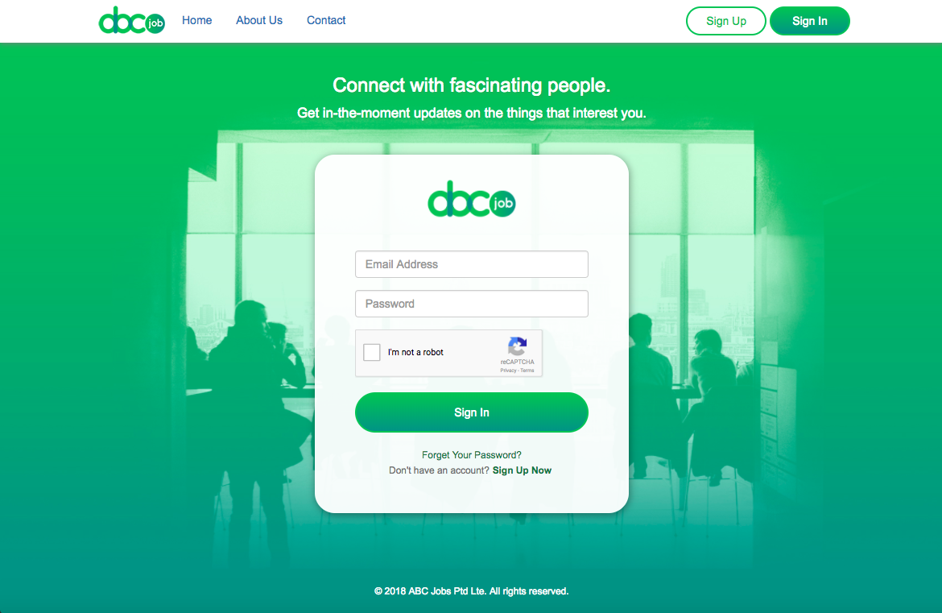
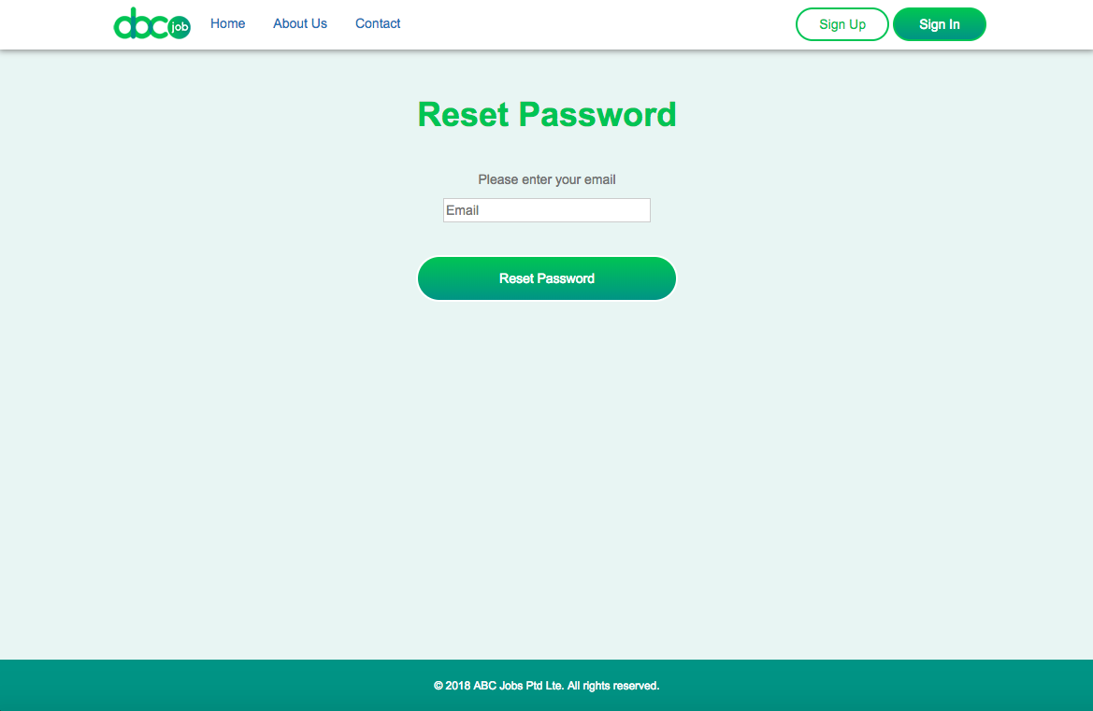
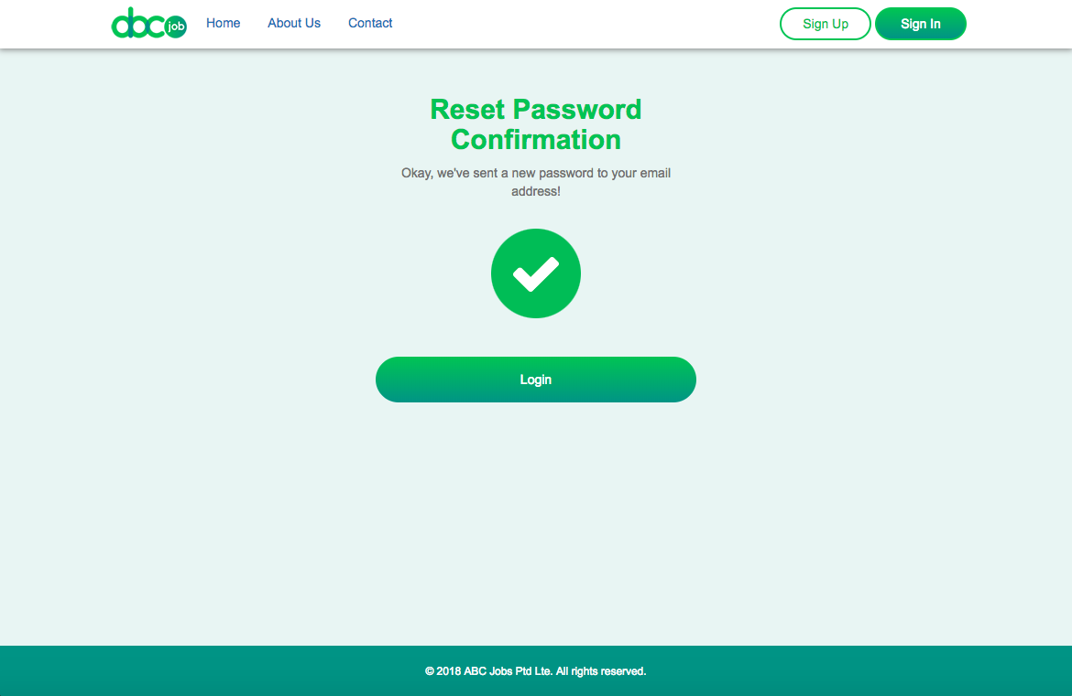
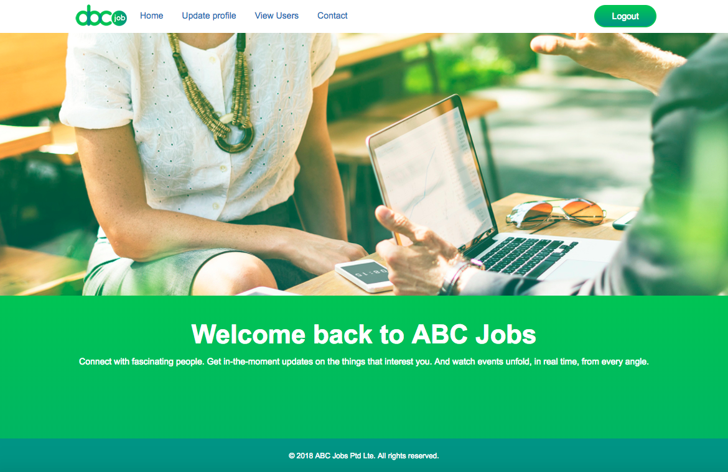
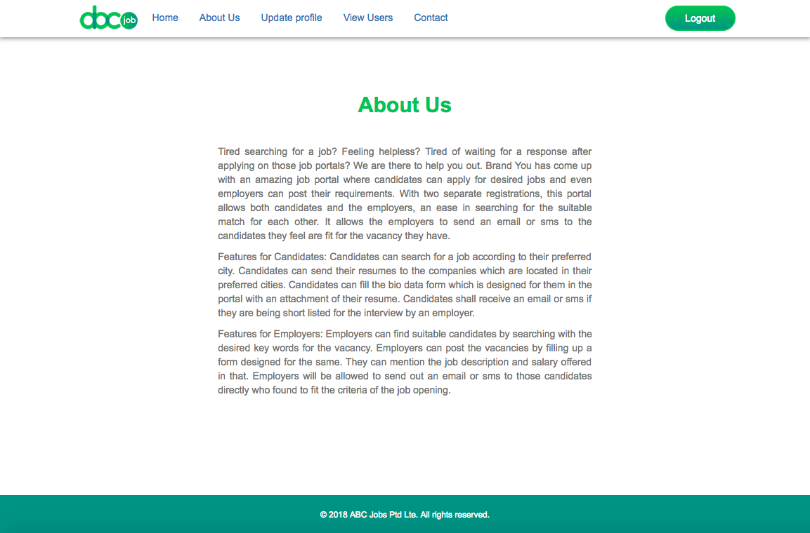
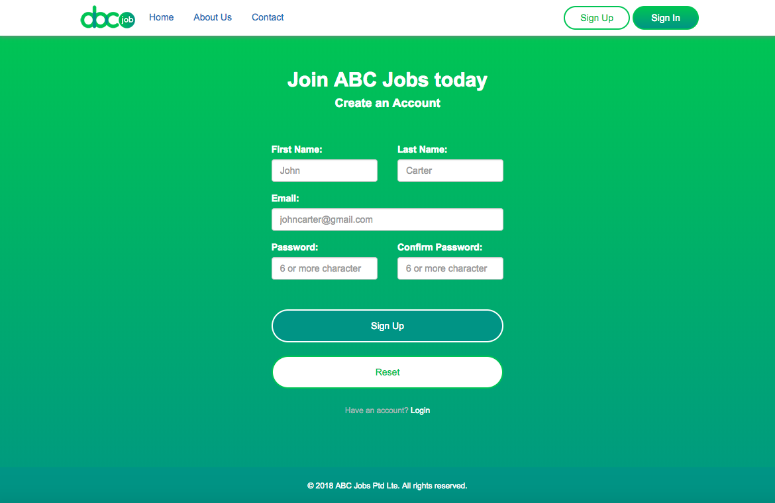
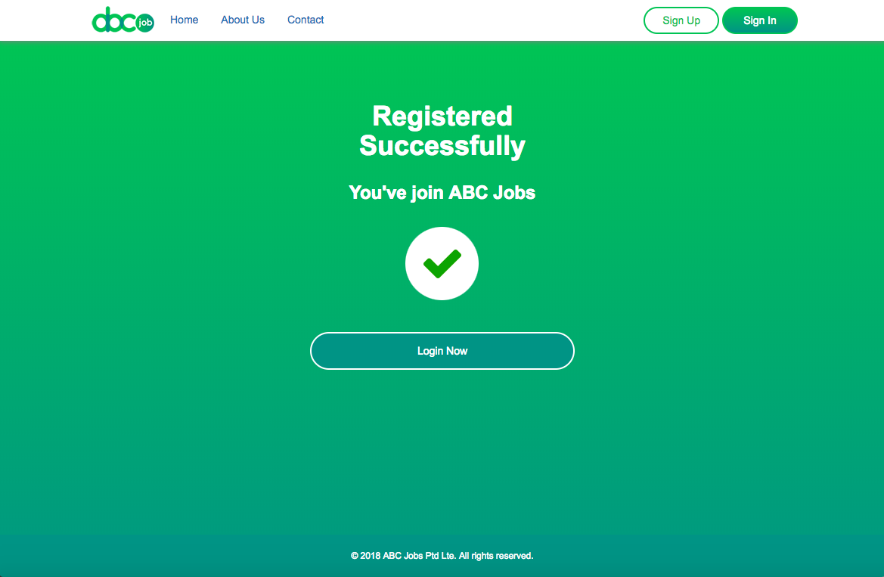
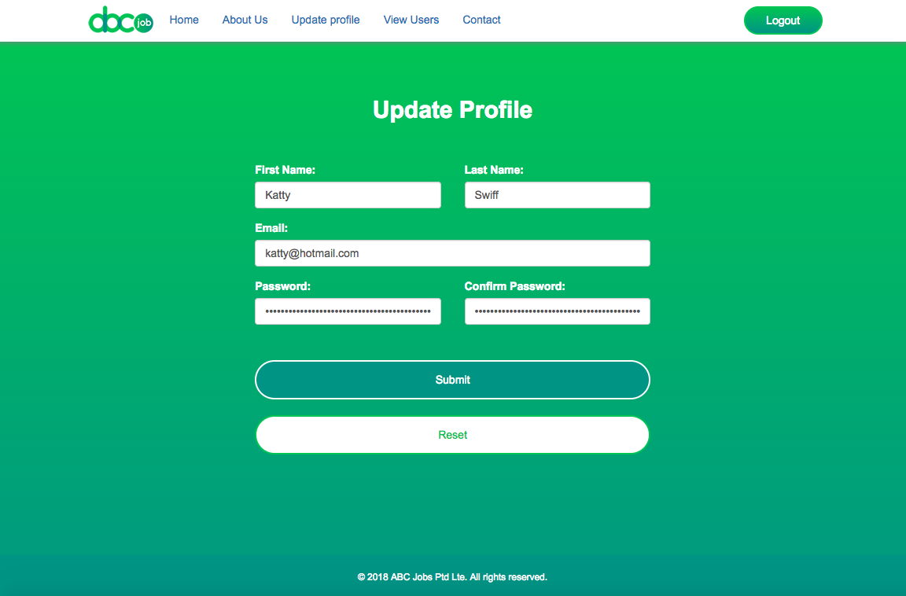
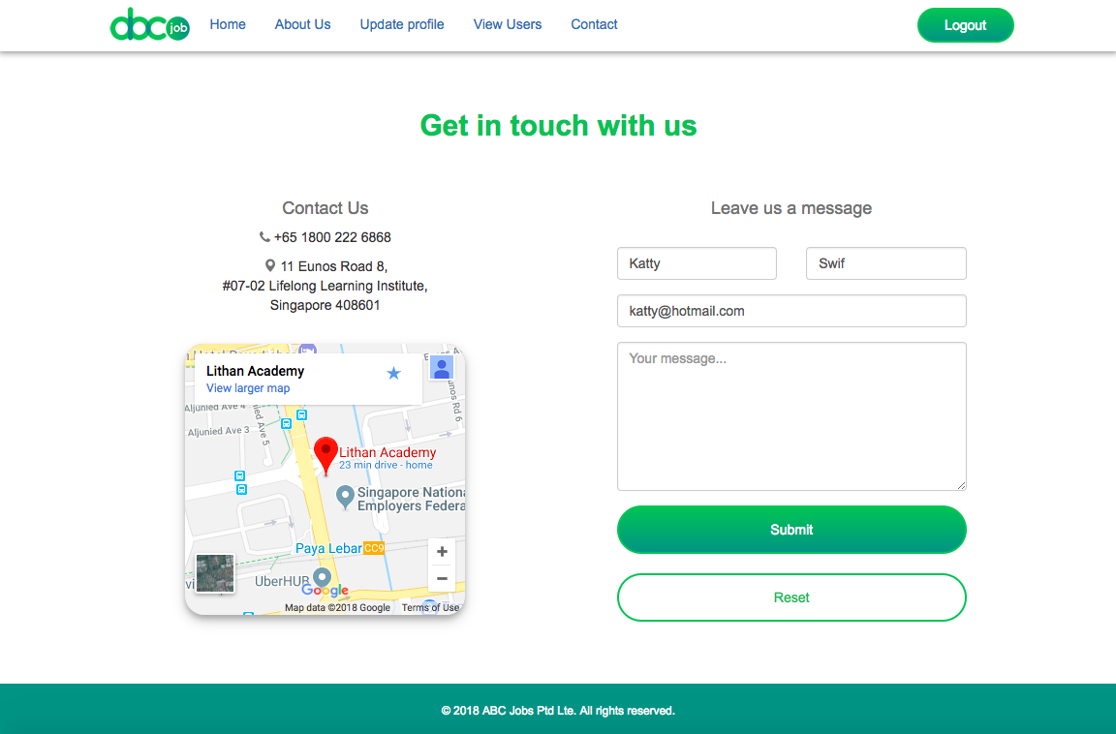
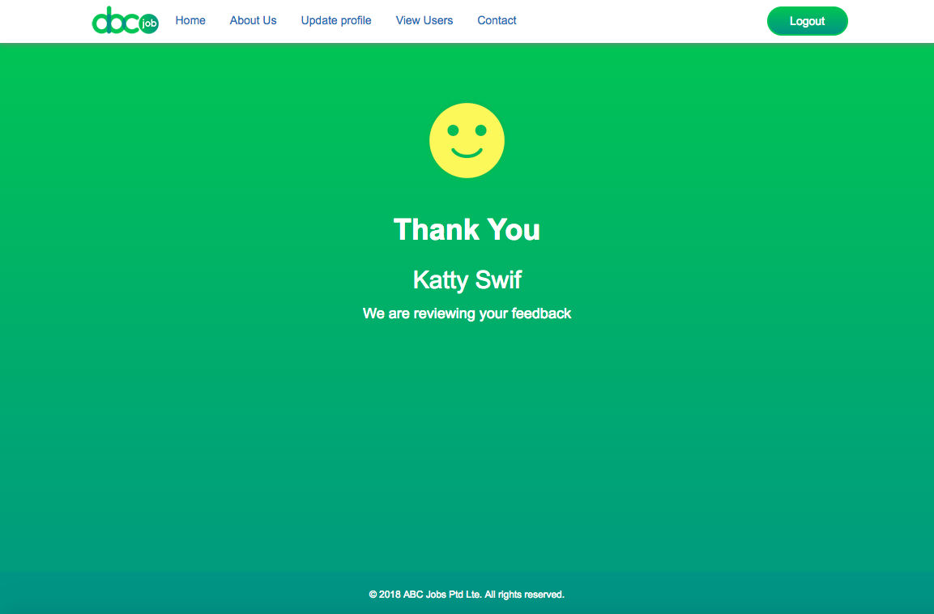
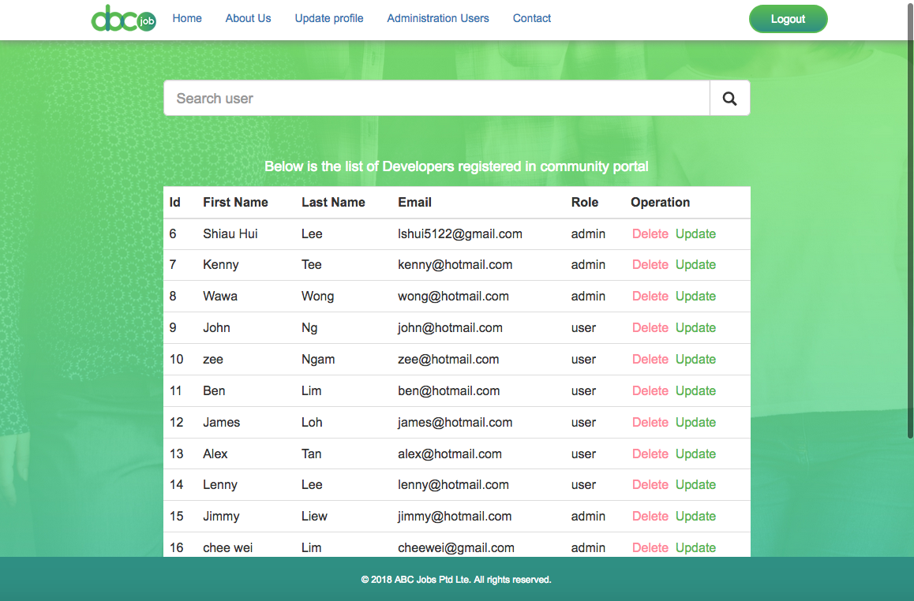
Login Page
https://projects.lithan.com/students/m1/run8/shlee/m5Project/public/login.php

Slide 3
Login Page
Open below url in web browserhttps://projects.lithan.com/students/m1/run8/shlee/m5Project/public/login.php
You will see the login page look like below :
Header Navigation
About Us – click on it will go to about us page which contain information of ABC Jobs company
Contact Us - Click on it will show you the contact information of ABC Jobs and user can submit feedback form.
Sign Up Button – New user who wish to register as a member of ABC Jobs portal can click on this button, will go to register page.
Empty Fields (Email Address & Password) - Registered user, please key in your email & password in the empty fields
Check box – Please check it to prove that user are not a robot
Sign In button – After fill in email, password & checked the check box, please click on sign in button login to community portal.
Forgot Your Password - User who forgot the password, please click on “Forgot Your Password”, it will redirect to Reset Password page.
Sign Up Now - User who would like to register as member of ABC Jobs, please click here to register page.

Slide 4
Login page > Reset Password Page
Please fill up your email address and click on Reset Password button
After submit request will redirect to below page, it inform user an email with new password have sent out to user email. User can click on login button back to login page.

Slide 5
Login page > Register Page
Please fill up the empty fields accordingly and click on Sign Up button to submit.
After submit request will redirect to below page, it inform user have successfully register as member of ABC Jobs community portal, please click login button to login.
Form (All fields are compulsory)
First Name – write your firstname (alphabet only)
Last Name – write your firstname (alphabet only)
Email – write your email
Password - Password must consist of at least 6 characters with at least one uppercase letter, one lowercase letter and one digit.
Comfirm Password – re-type again your password
Reset – reset fields to empty fields

Slide 6
Login page > Home Page
After login will go into home page look like below :
Update Profile - Click on it will go to update profile page, user able to update profile in this page
View User – Click on it will go to View User page, user albe to search and view other user in this page
Logout button – Click on it and user will log out from ABC Jobs community portal

Slide 7
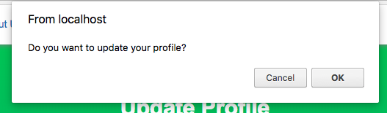
Login page > Home Page > Update Profile
You may update the profile in this page.
After make changes, please submit, a message will prompt out to check weather you want to update your profile or not. Click ok to process.
Form (All fields are compulsory)
First Name – write your firstname (alphabet only)
Last Name – write your firstname (alphabet only)
Email – write your email
Password - Password must consist of at least 6 characters with at least one uppercase letter, one lowercase letter and one digit.
Comfirm Password – re-type again your password
Reset – reset fields to empty fields

Slide 8
Login page > Home Page > About Us
About Us – You may want to know more information about ABC Jobs community portal from this page.

Slide 9
Login page > Home Page > Contact
Please fill up the messages and click on submit button.
Your message have send to ABC Jobs community portal

Slide 10
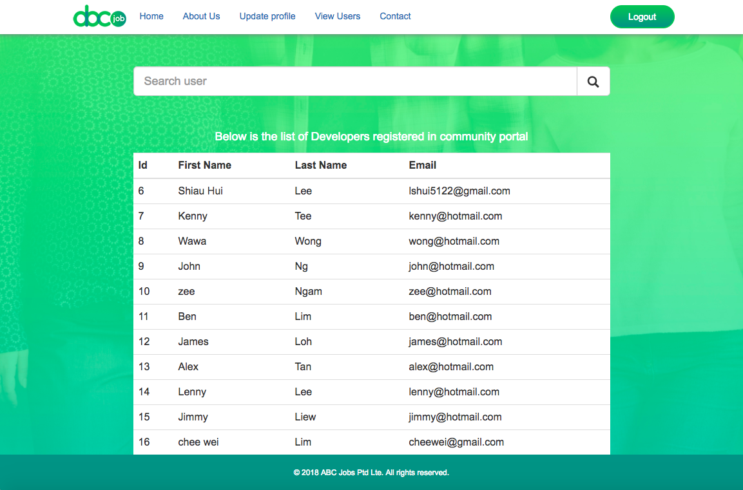
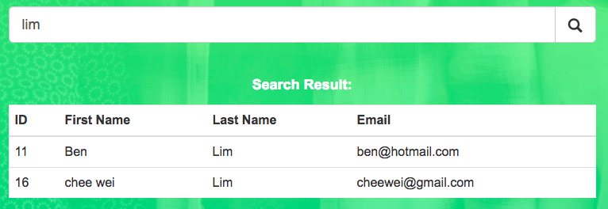
Login page > Home Page > View Users
Search user by key in keyword and click on search icon.
The result will show as per below

